Slide 1
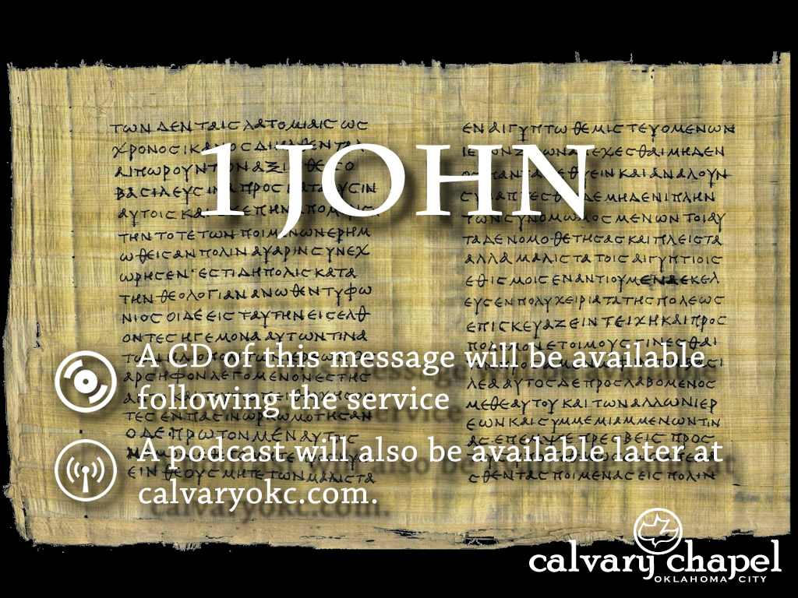
1:1-4

Slide 2
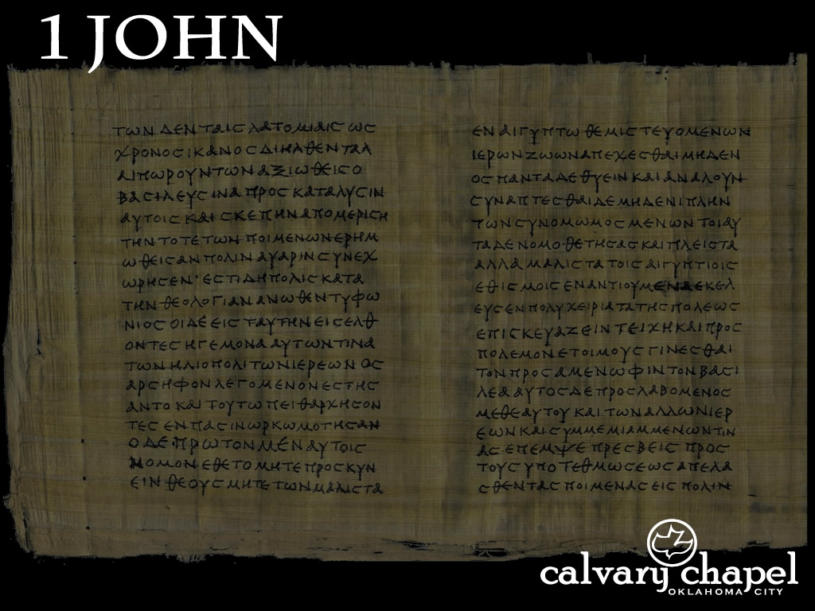
1:1-4
Roman Catholics
Southern Baptists
“How many
women w/ PMS
does it take to change a light bulb?”
Episcopalians
Pentecostals
Calvary Chapels
15
1
0
3
10
???
ONLY ONE!

Slide 3
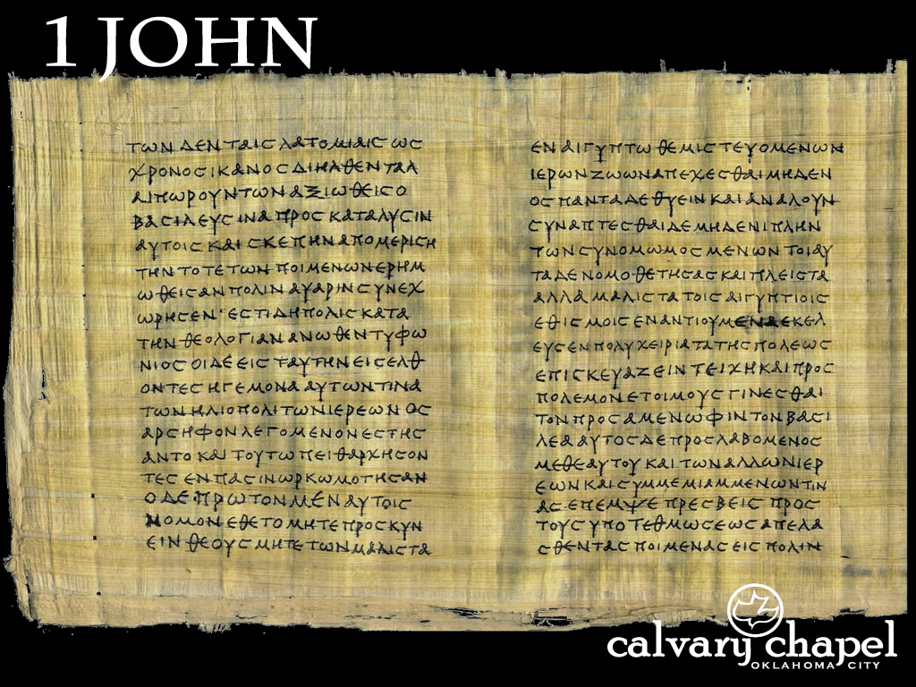
1:1-4

Slide 4
1:1-4
Written from Ephesus c. AD 90-95 (capital of Asia Minor)
Polycarp, Papias, Iraneas, etc. all acknowledge the Apostle John as the author
My little children 9x in this letter

Slide 5


1:1-4
My name is Jesus Christ

Slide 6
1:1-4
Love ~ 23x in this letter
Luke 9:52b-54 ~ ^{52b} And as they went, they entered a village of the Samaritans, to prepare for Him. ⁵³ But they did not receive Him, because His face was set for the journey to Jerusalem. ⁵⁴ And when His disciples James and John saw this, they said, “Lord, do You want us to command fire to come down from heaven and consume them, just as Elijah did?”

Slide 7
1:1-4
Acts 20:29-31 ~ ²⁹ For I know this, that after my departure savage wolves will come in among you, not sparing the flock. ³⁰ Also from among yourselves men will rise up, speaking perverse things, to draw away the disciples after themselves. ³¹ Therefore watch, and remember that for three years I did not cease to warn everyone night and day with tears.

Slide 8
1:1-4
Gnosticism ~ “the beliefs and practices of pre-Christian and early Christian sects, condemned by the church, especially the conviction that matter is evil and that knowledge is more important than faith, and the practice of esoteric mysticism.”
“knowledge” ~ gnōsis

Slide 9
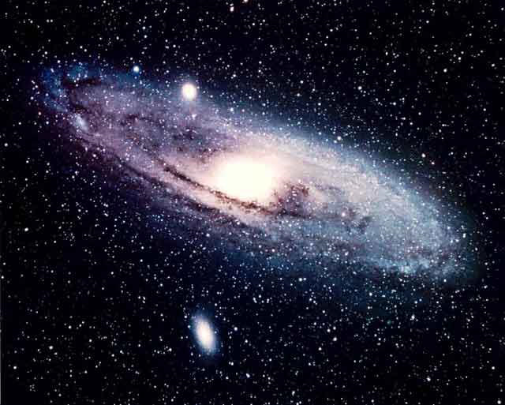
1:1-4
All-powerful
Unnamed Father
All-good
Less Powerful
Less
Less
Less
Less
Less Good
Lesser
Lesser
Lesser
Lesser
Lesser
Lesser
Least
Least
Least
Least
Least
Least
Least
Least
Least
Least
Least
You are here

Slide 10
1:1-4

Slide 11
1:1-4
Three beginnings:
Genesis 1:1 ~ In the beginning, God created the heavens and the earth.
Beginning of the physical world
John 1:1 ~ In the beginning was the Word, and the Word was with God, and the Word was God.
Beginning of eternity
1 John 1:1 ~ That which was from the beginning…
Beginning of the Incarnation

Slide 12
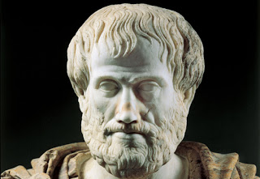
1:1-4
Word ~ logos
Aristole ~ Logos = Reason
384 – 322 BC

Slide 13
1:1-4
seen with our eyes ~ witnessed
have looked upon ~ examined
hands have handled ~ touched

Slide 14
1:1-4

Slide 15
1:1-4
manifested ~ phaneroō – to make visible
cp. w/ apokaluptō – to uncover or unveil
eternal life is a Person
1 John 2:25 ~ And this is the promise that He has promised us — eternal life.

Slide 16
1:1-4

Slide 17
1:1-4
Fellowship ~ koinonia – partnership, communion, to share together
4x in chapter 1

Slide 18
1:1-4

Slide 19
1:1-4
David Guzik ~ “Speaking honestly, for many people, this is totally unappealing. Sometimes it is because they don’t know who God is, and an invitation to a ‘personal relationship with God’ is about as attractive to them as telling an eighth-grader they can have a 'personal relationship with the assistant principal.’”

Slide 20
1:1-4

Slide 21
1:1-4
Ps. 16:11 ~ You will show me the path of life; In Your presence is fullness of joy; At Your right hand are pleasures forevermore.
John 15:11 ~ These things I have spoken to you, that My joy may remain in you, and that your joy may be full.
full ~ NIV, complete – better, completed (perfect tense)

Slide 22
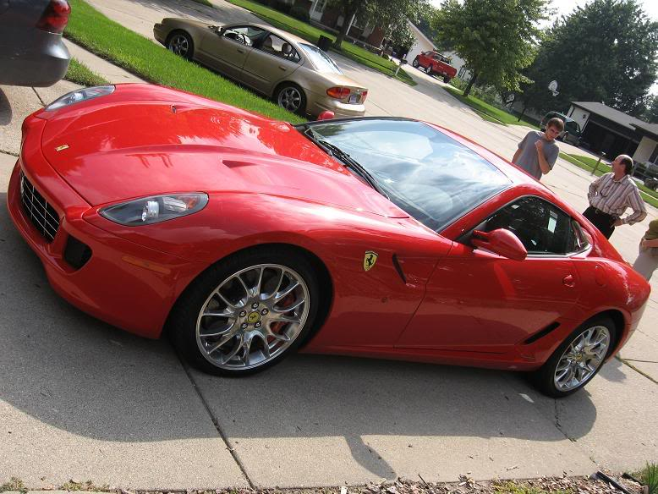
1:1-4

Slide 23
1:1-4

